Slide 1

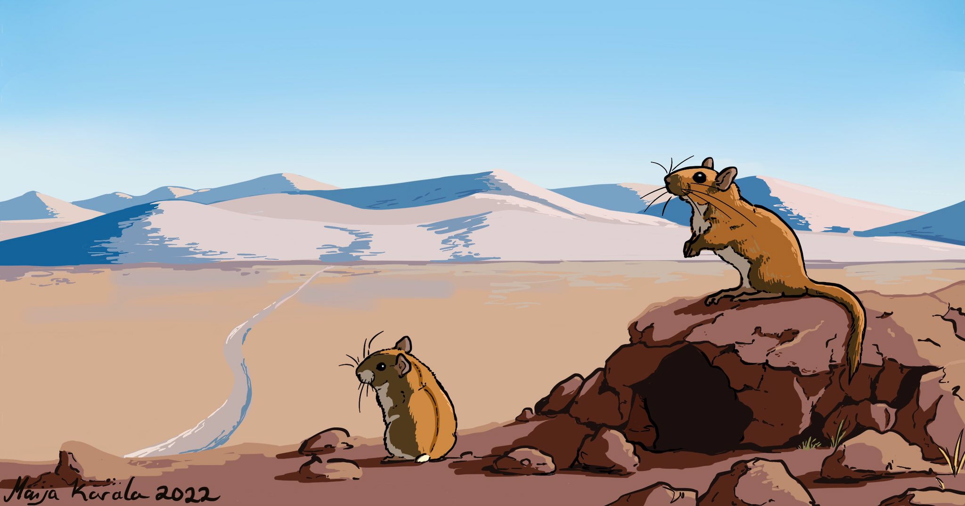
An energy budget model for terrestrial mammals

Slide 2


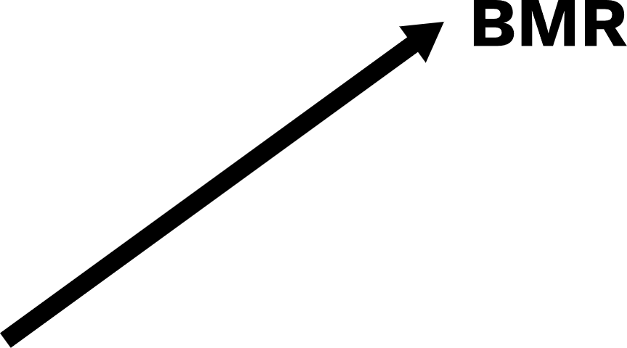




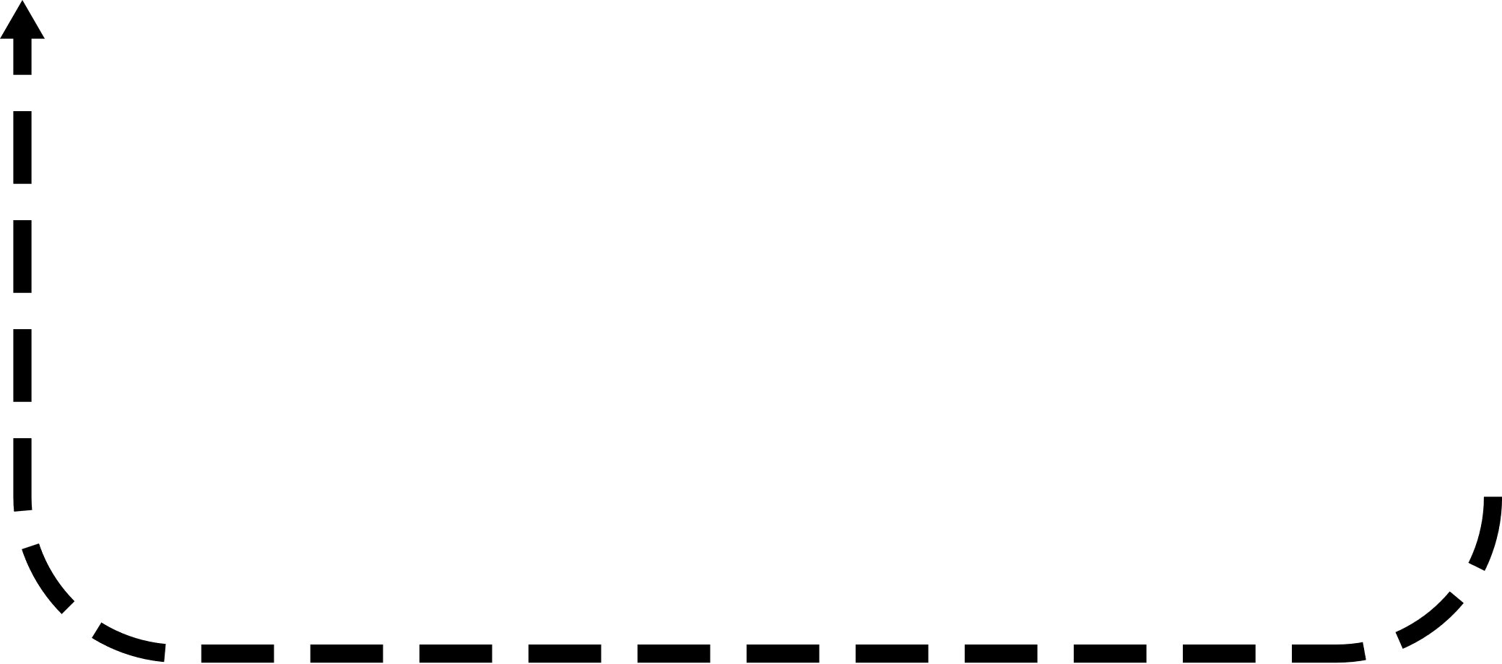



Energy budget model overview

Slide 3
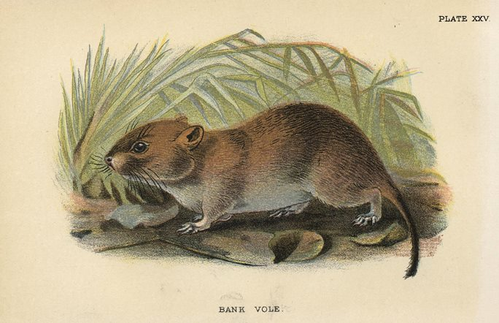
Parameterized for bank voles

Slide 4
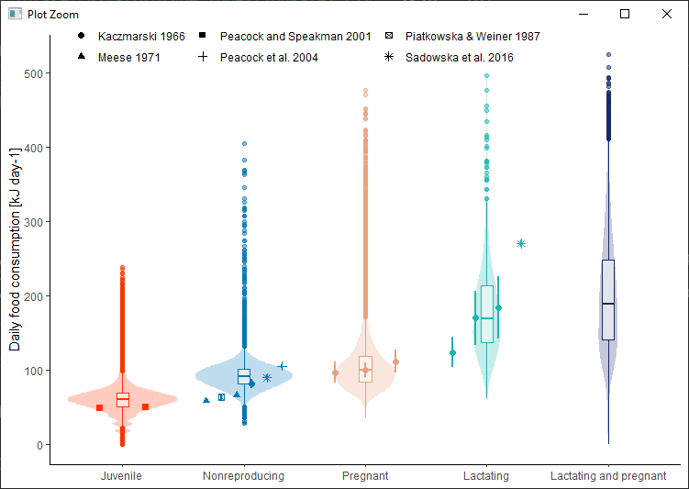
Ingestion rates

Slide 5
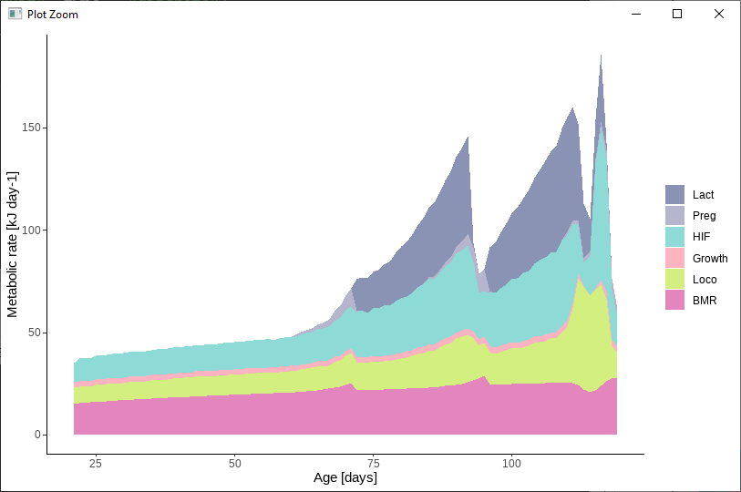
Field metabolic rates

Slide 6
First application
DEE
Mass
Notes:
240 Calories to 1 MJ

Slide 7
First application
How does the environment shape the evolution of different metabolic phenotypes?
The food habits hypothesis identifies 3 dietary components that can drive average and variability of metabolic rates:
Quality, Availability, and Predictability
Bozinovic et al. 2007
Notes:
“….the evolution of a low mass-independent BMR is likely to occur in habitats where food availability is low and/ or unpredictable (McNab 2002; Cruz-Neto and Jones 2005)”

Slide 8
First application
How does the environment shape the evolution of different metabolic phenotypes?
Introduce variation in and heritability of three metabolic traits:
Maintenance costs
Energy allocation to growth
Energy allocation to reproduction
Notes:
“….the evolution of a low mass-independent BMR is likely to occur in habitats where food availability is low and/ or unpredictable (McNab 2002; Cruz-Neto and Jones 2005)”

Slide 9
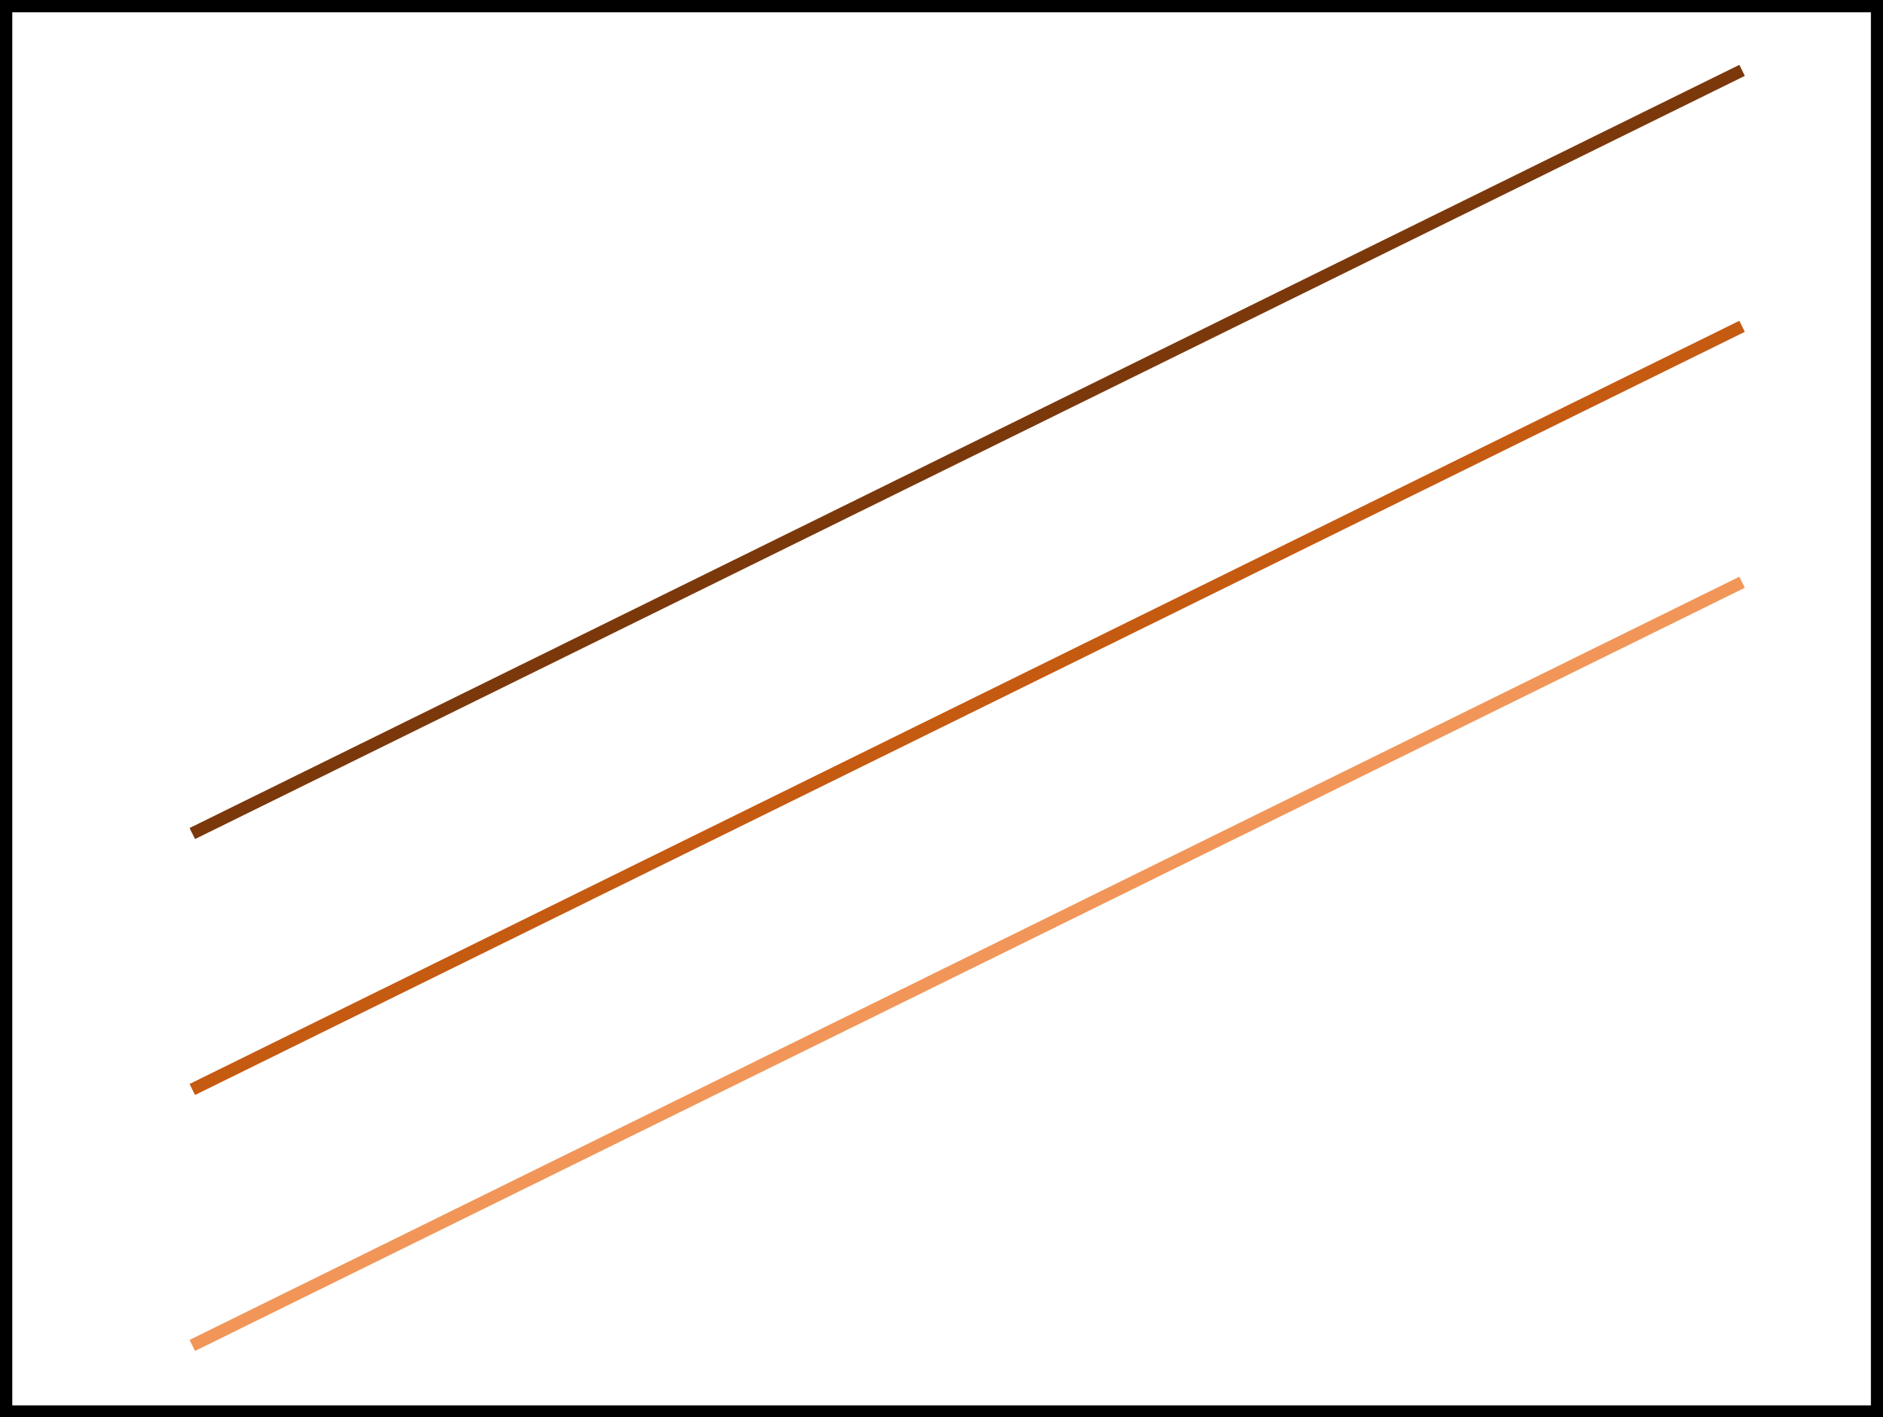
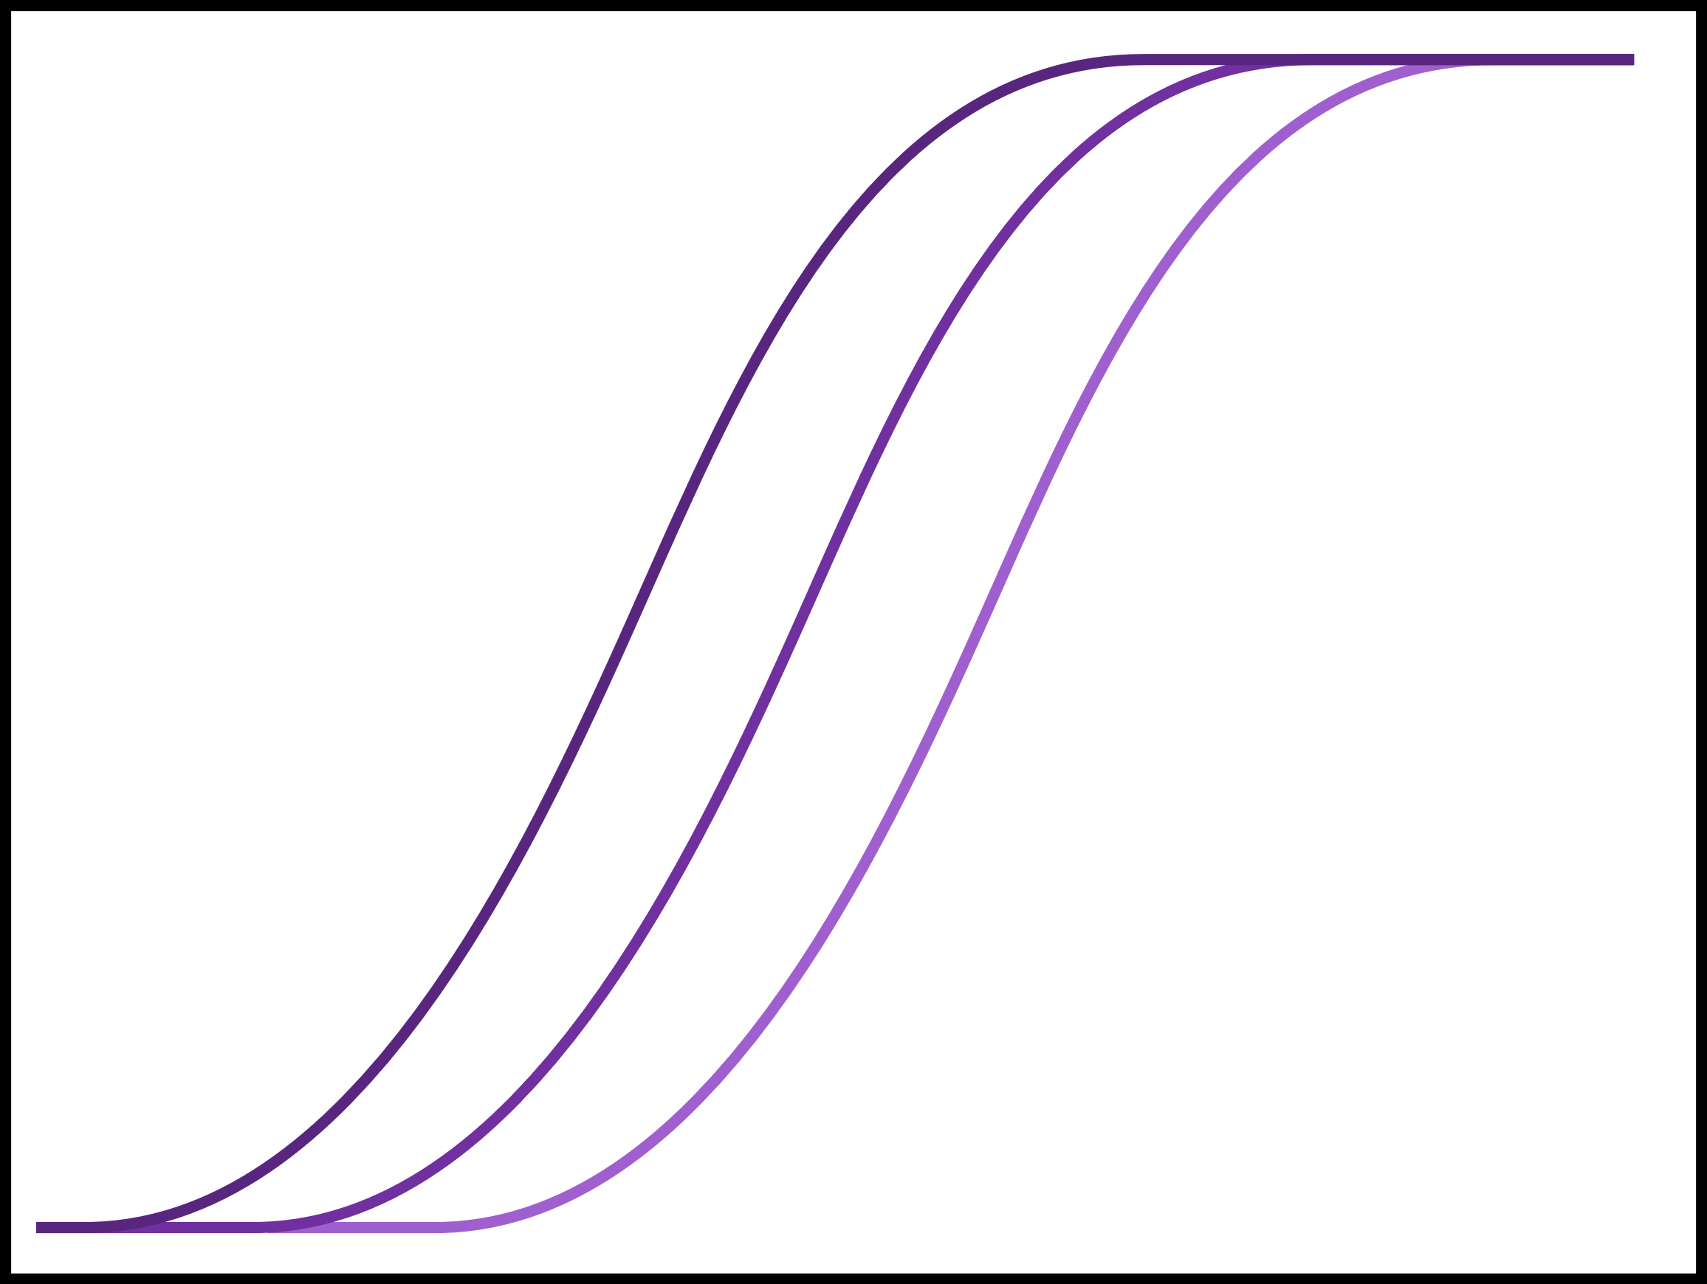
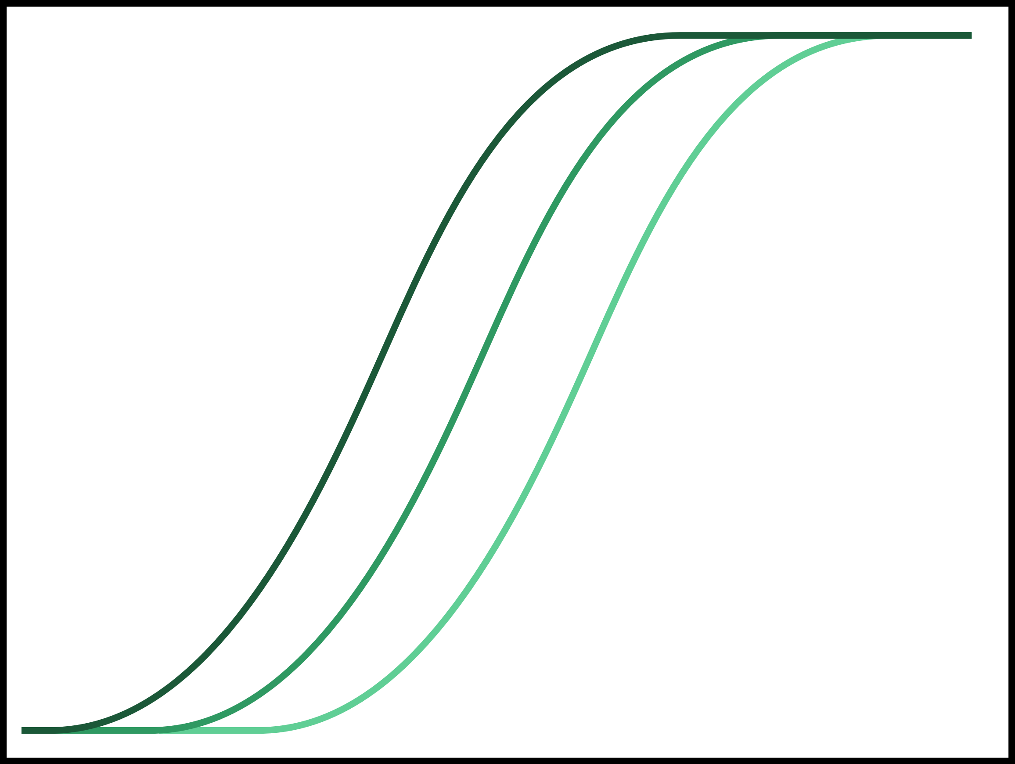
First application
How does the environment shape the evolution of different metabolic phenotypes?
Maintenance costs
Energy allocation to growth
Energy allocation to reproduction
BMR
Allocation %
Allocation %
Body mass
Body fat %
Body fat %
Notes:
“….the evolution of a low mass-independent BMR is likely to occur in habitats where food availability is low and/ or unpredictable (McNab 2002; Cruz-Neto and Jones 2005)”

Slide 10




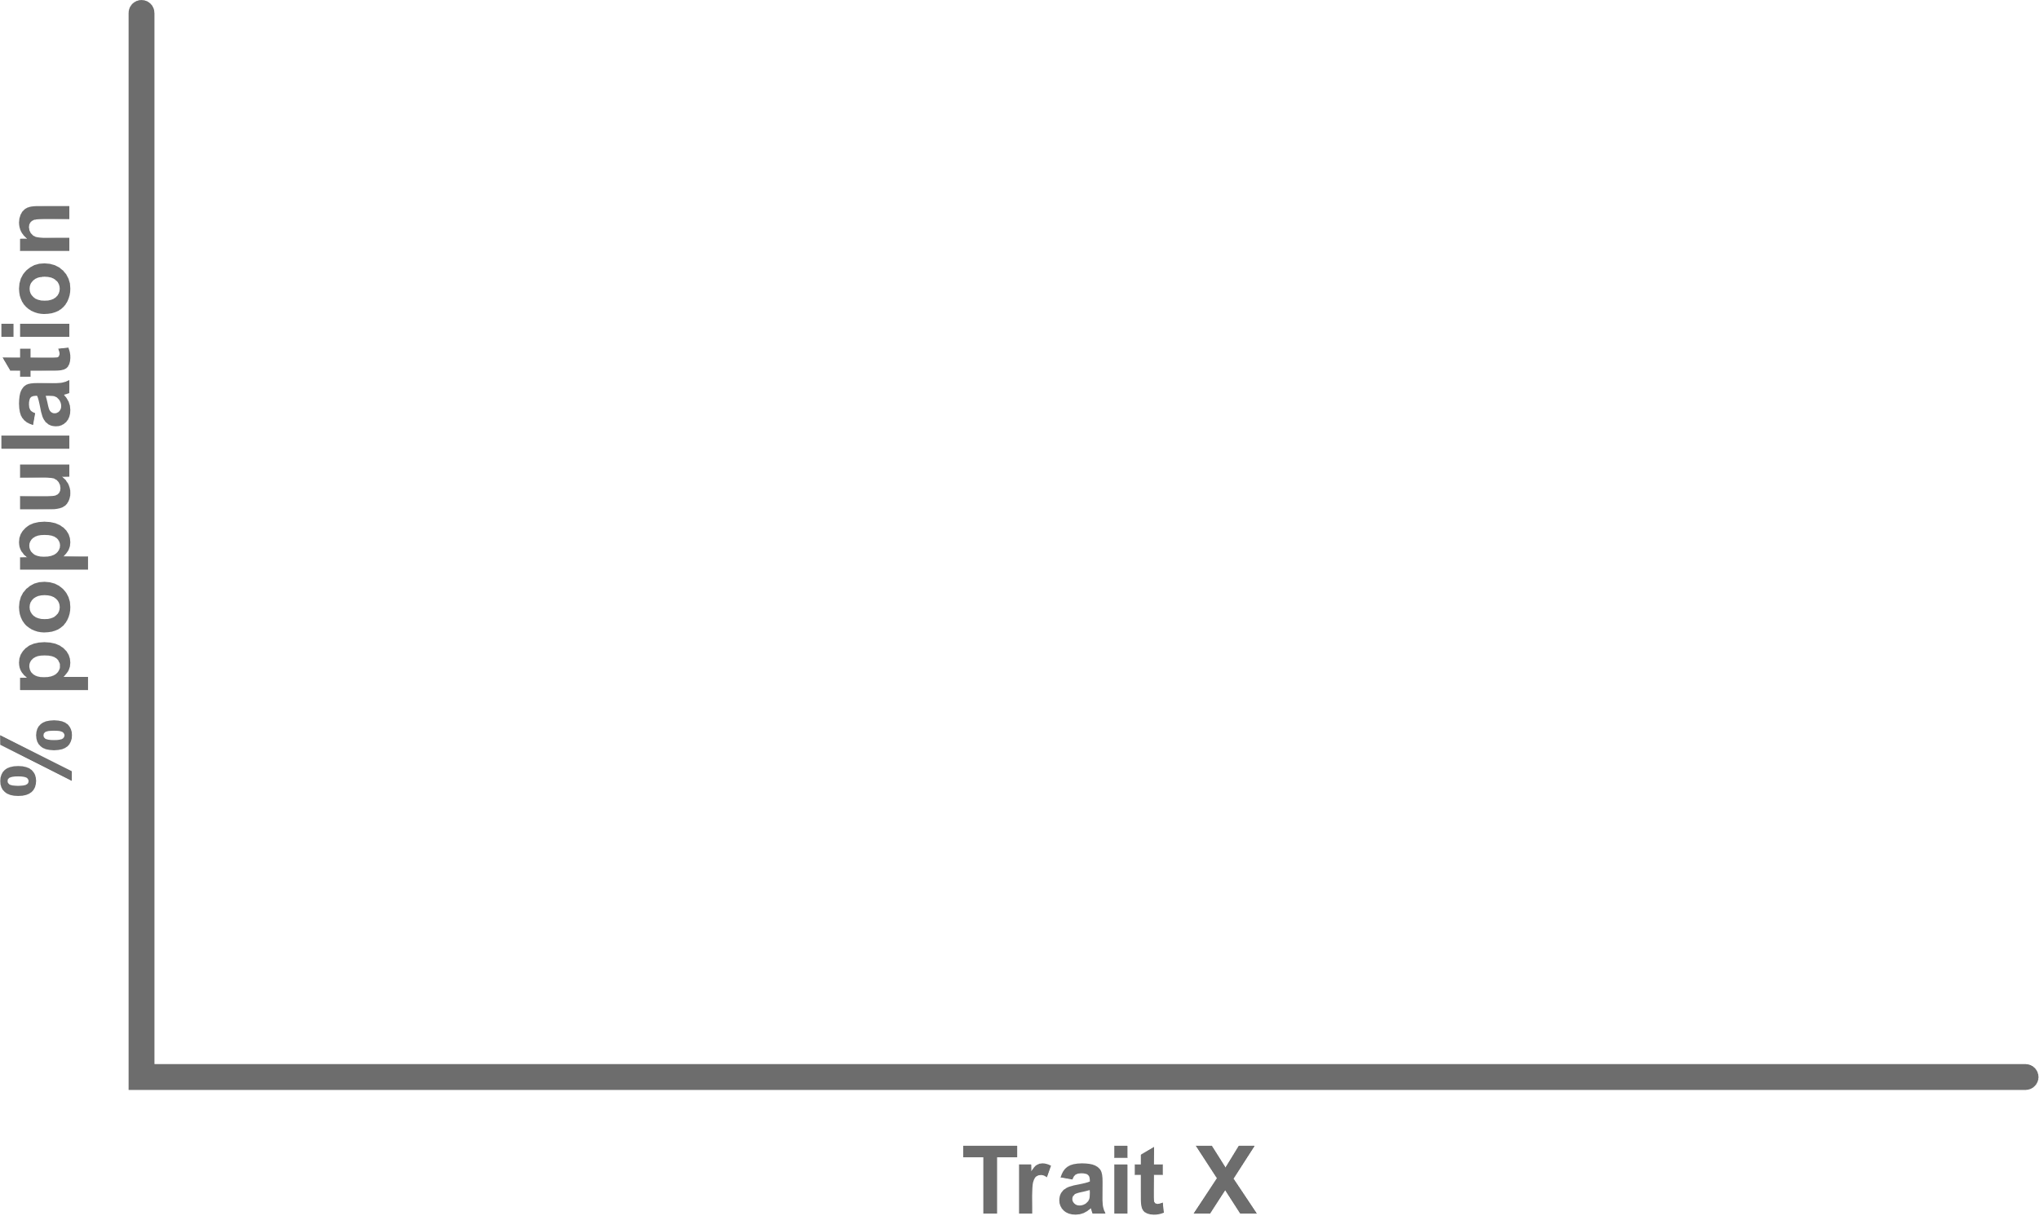
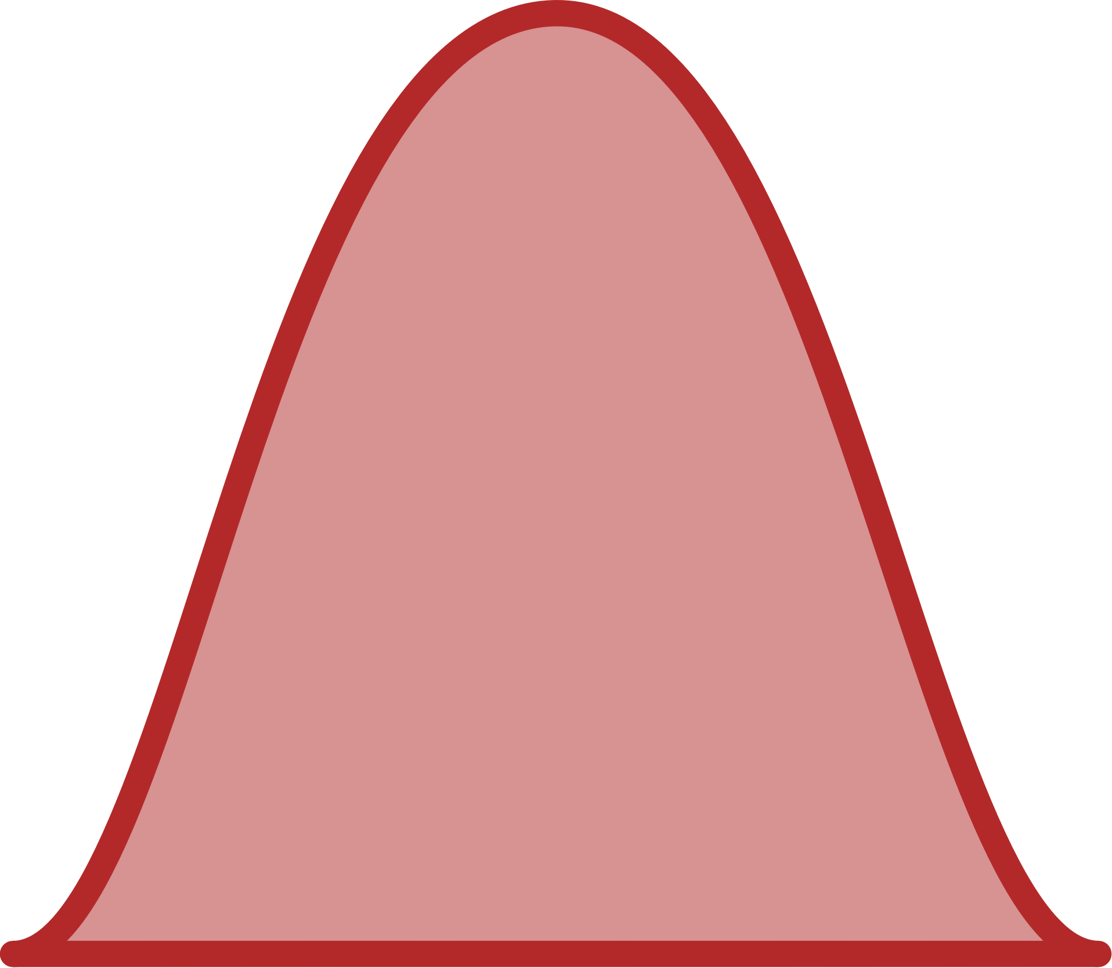
How does the environment shape the evolution of different metabolic phenotypes?
Notes:
Can test things like how the rate of change affects success, long term versus short term environmental changes, combine with other stressors like predation, etc.

Slide 11
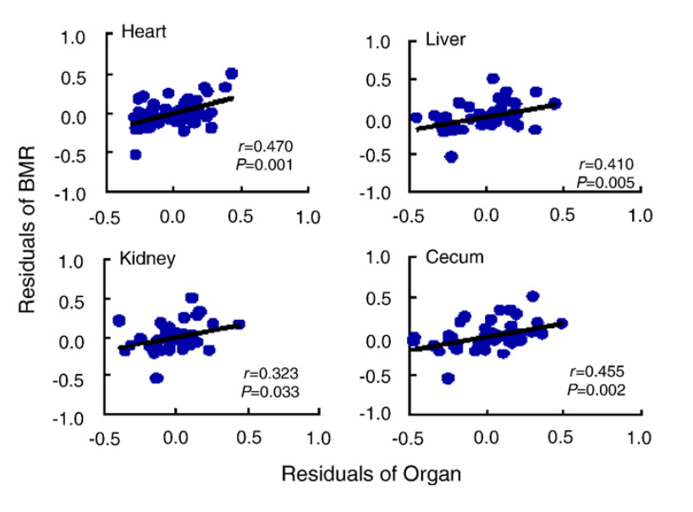
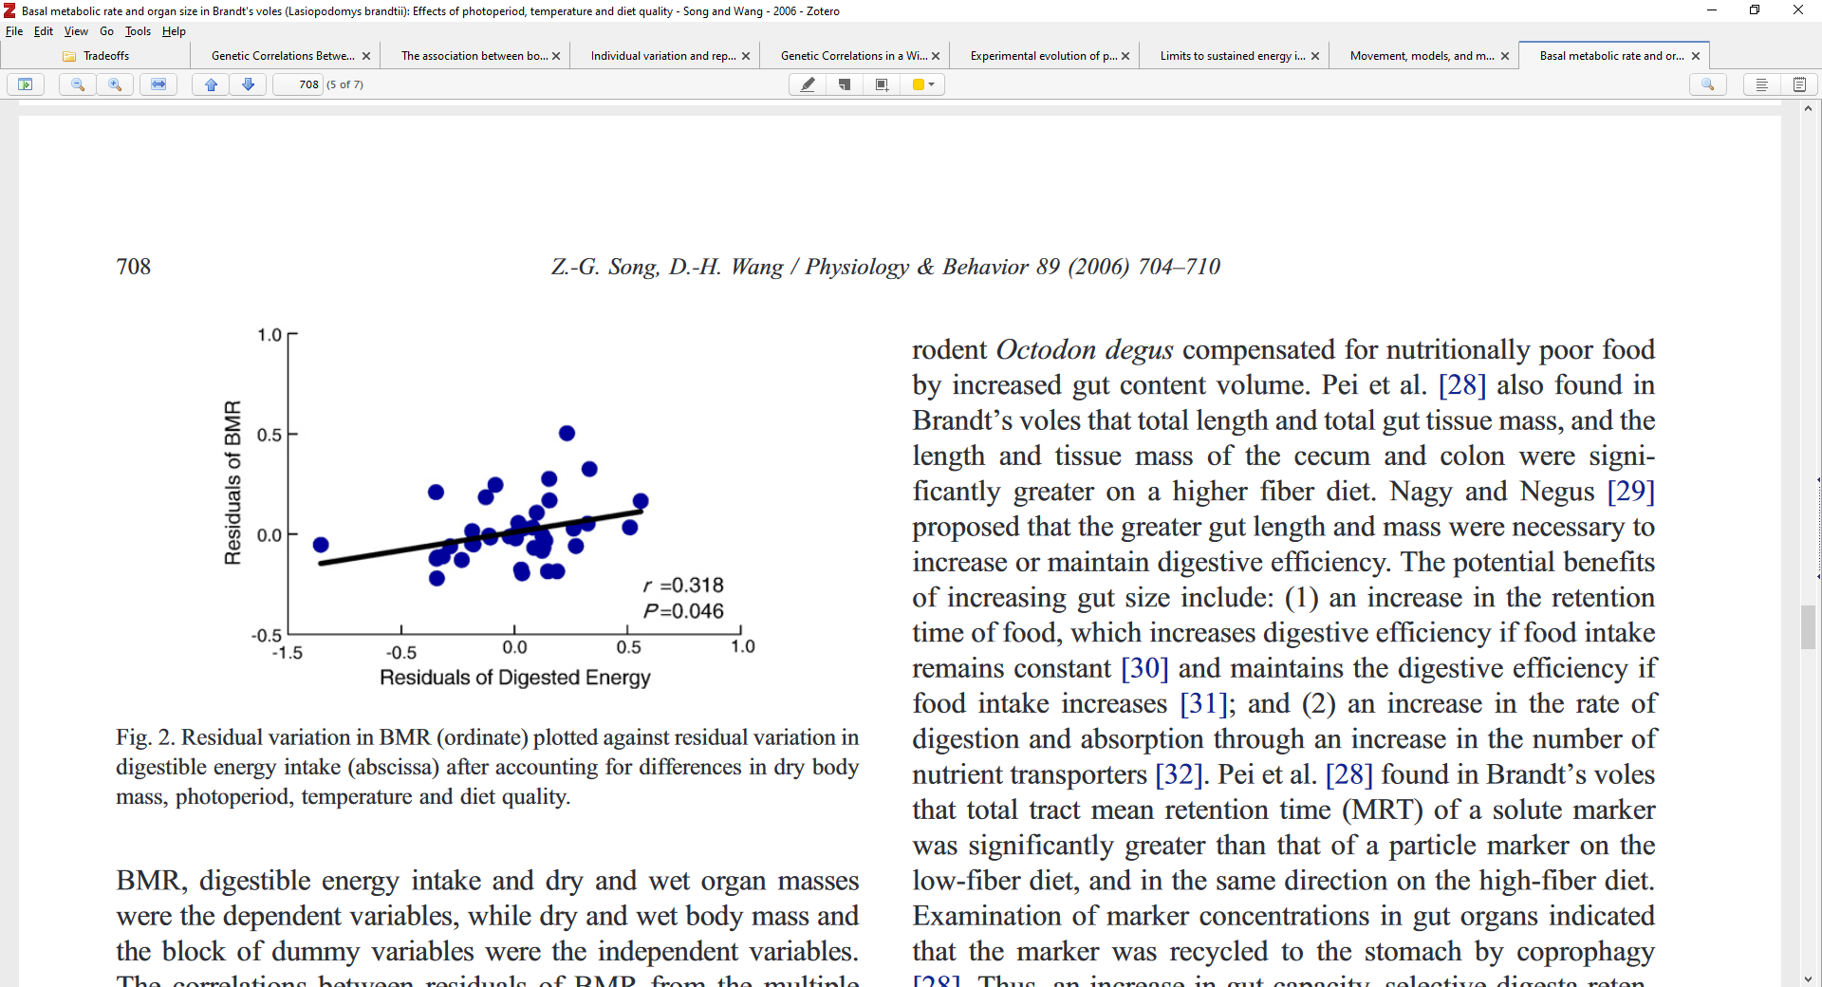
First application
Notes:
“….the evolution of a low mass-independent BMR is likely to occur in habitats where food availability is low and/ or unpredictable (McNab 2002; Cruz-Neto and Jones 2005)”

